Slide 1

Network as a Service: Transforming the Enterprise Marketplace
March 2020

Slide 2




Oren Marmur,
VP, Head of NFV
Jim Hodges
Chief Analyst - Cloud and Security

Slide 3
Network as a Service: The Enterprise Perspective

Slide 4
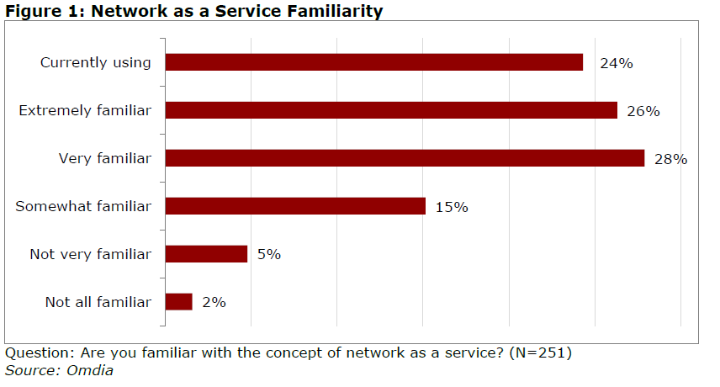

Slide 5
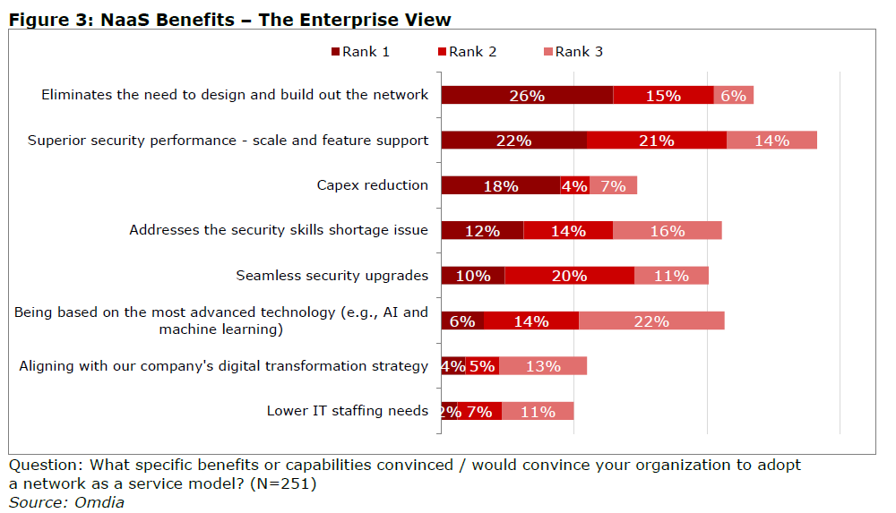

Slide 6
Source: How likely is it that you would buy, configure, and self-provision the following services from your existing main network service provider's portal (e.g., as a virtual network function)? (N=251)
Source: Omdia

Slide 7
Network as a Service: The Vendor Perspective

Slide 8
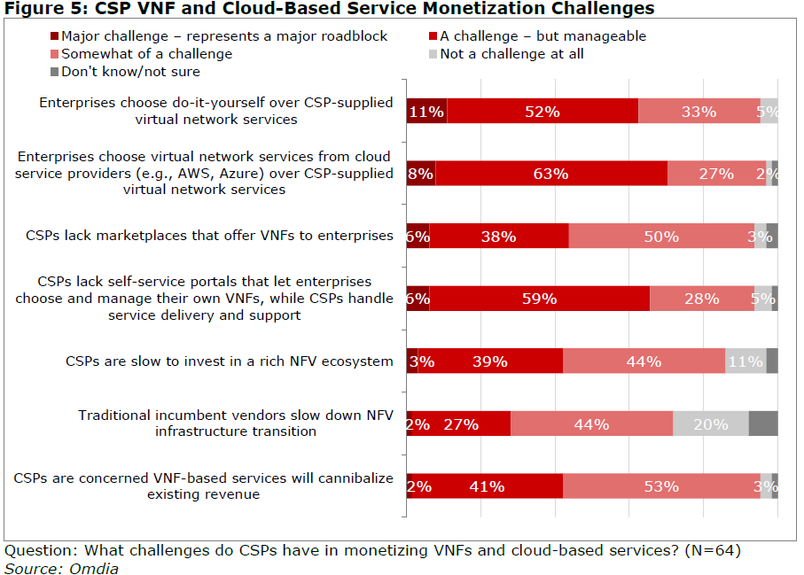

Slide 9
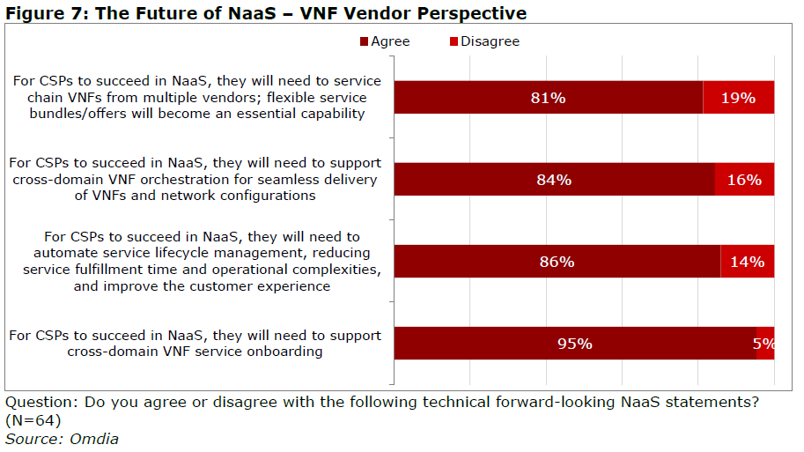

Slide 10
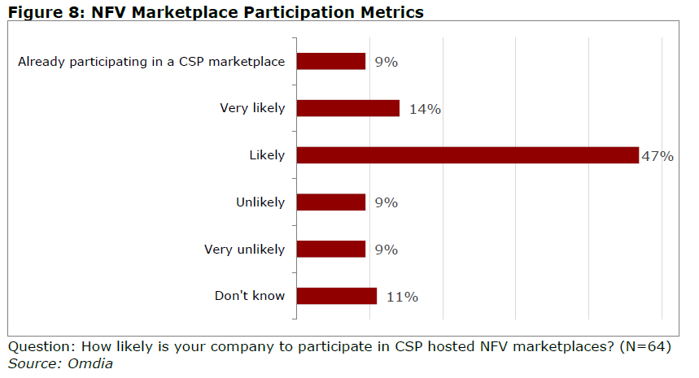

Slide 11
NAAS: The CSP Perspective

Slide 12
Question: How important are NaaS services strategically for your company? (N=99)
Source: Heavy Reading | Omdia

Slide 13
Question: How important are the following capabilities to your overall NaaS monetization strategy? (N=98-100)
Source: Heavy Reading | Omdia

Slide 14
Question: How much do the following technical and operational factors limit your ability to optimize the efficiency
of your NaaS deployment? (N=97)
Source: Heavy Reading | Omdia

Slide 15
Question: Do you agree or disagree that CSPs realize the following benefits from cross-domain orchestration? (N=98-100)
Source: Heavy Reading | Omdia

Slide 16
Question: Which statement best reflects your cross-domain orchestration implementation strategy? (N=99)
Source: Heavy Reading | Omdia

